Slide 1
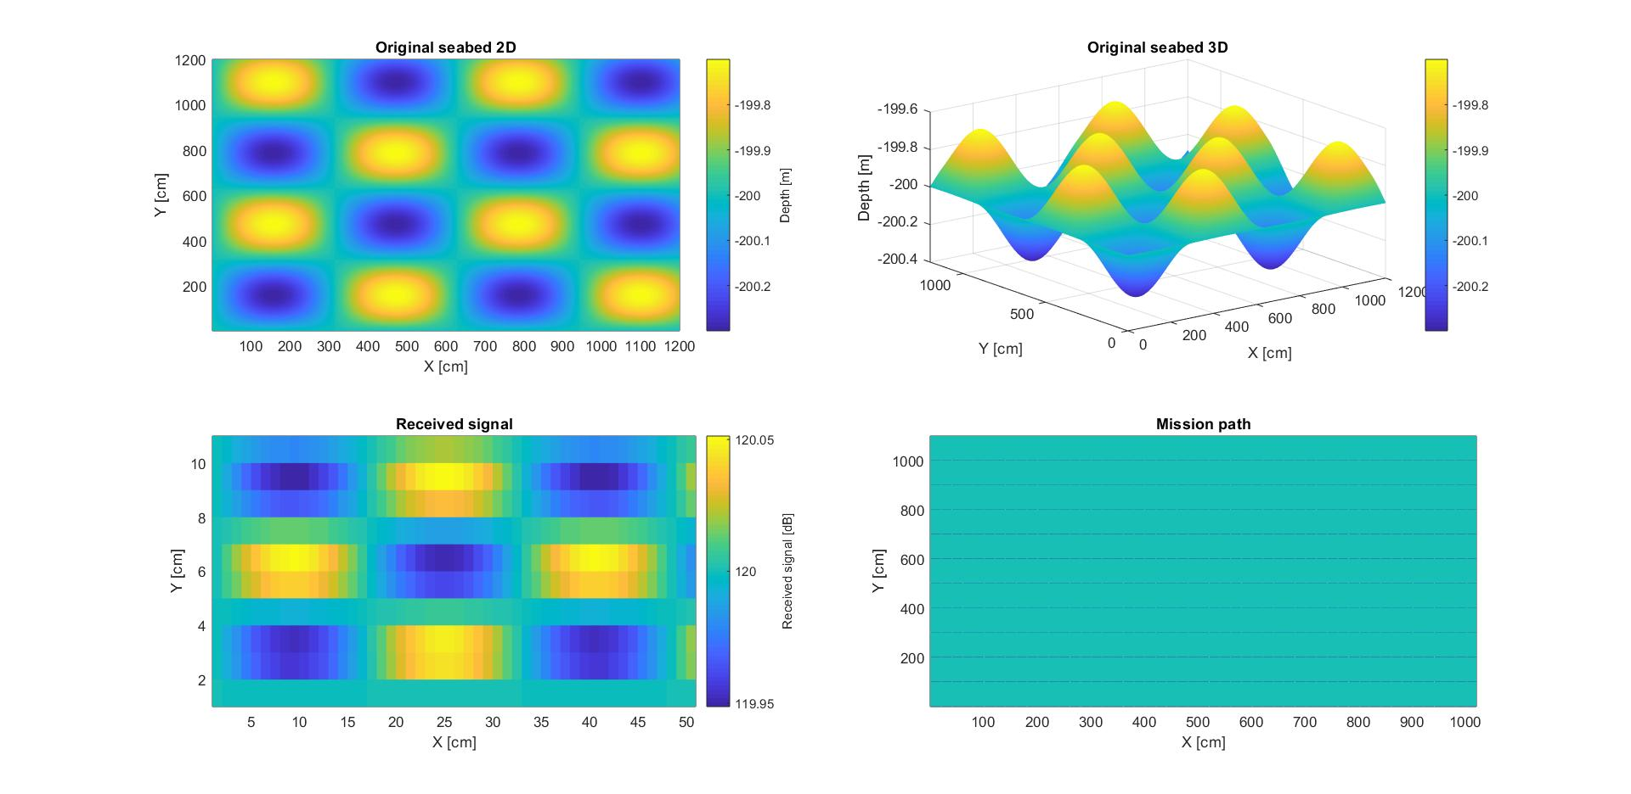
Bathymetry

Slide 2
Interpolation Method
Linear Interpolation
RBF
Spline Interpolation
Nearest Neighbor Interpolation
Natural Neighbor Interpolation
Biharmonic Spline Interpolation
Minimum Curvature
Shepard Interpolation
Kriging Interpolation

Slide 3
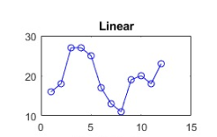
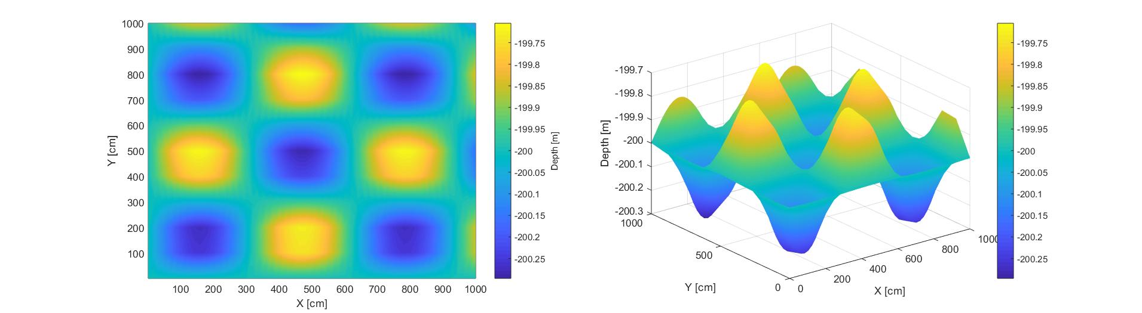
Linear Interpolation
This method fits a different linear polynomial between each pair of data points for curves, or between sets of three points for surfaces.
Error: 1.8280 e-04

Slide 4
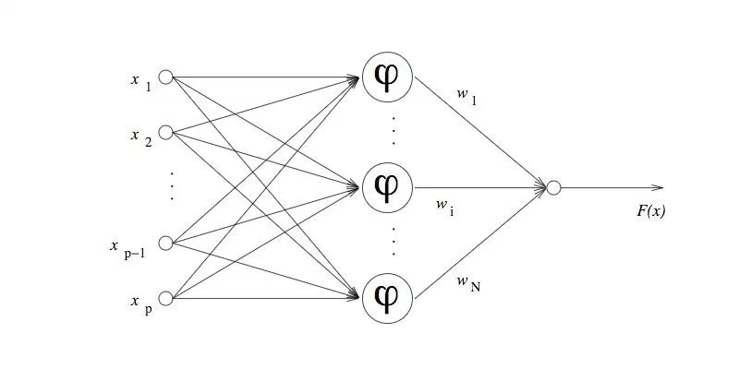
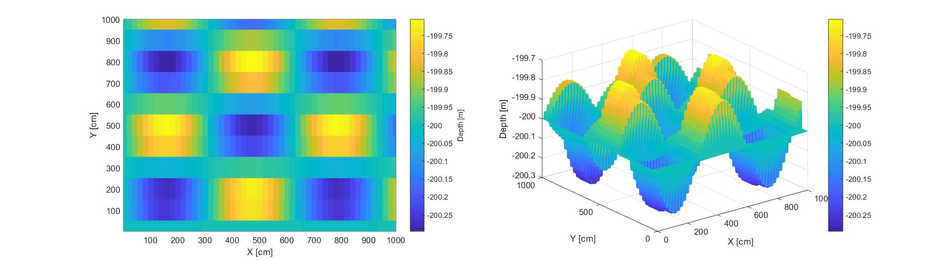
RBF
Method based on the neural networks.
Hidden Layer: 561 neurons
Output Layer: 1 neuron
Error: 0.0208

Slide 5
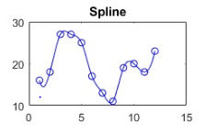
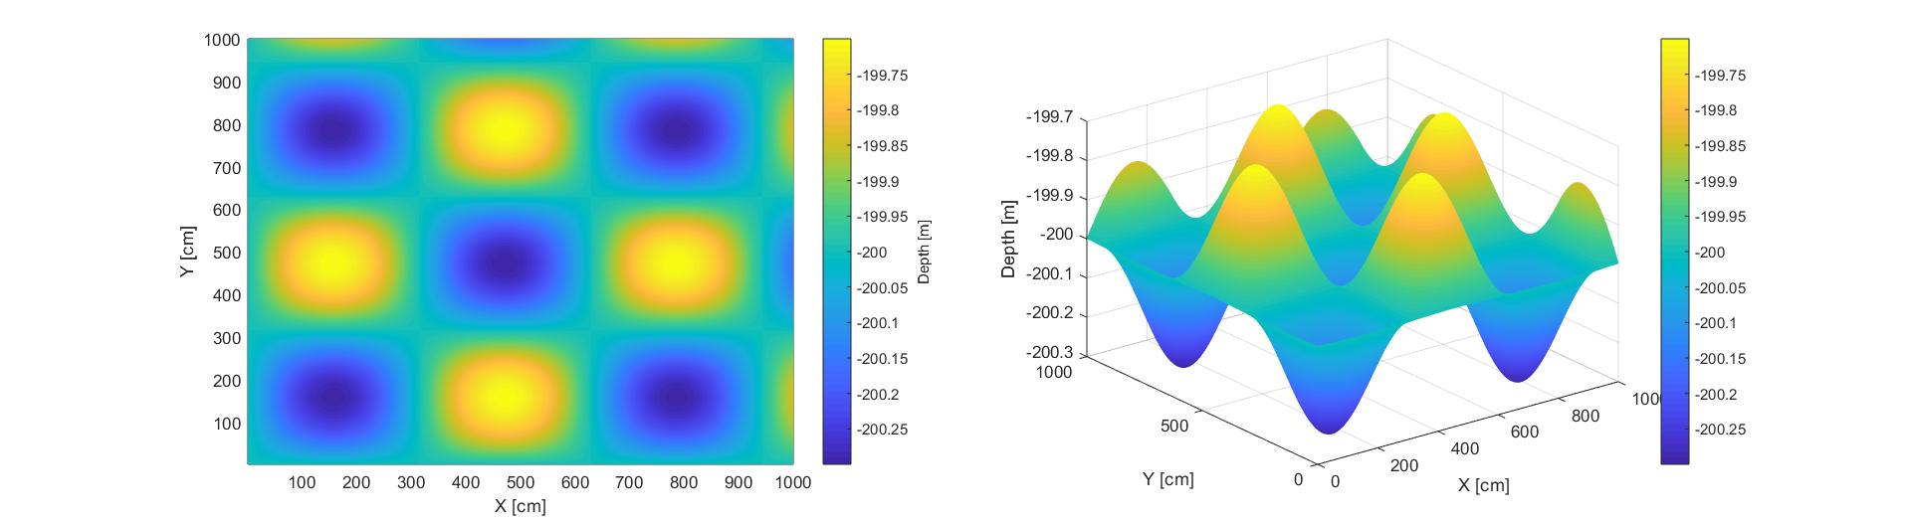
Spline Interpolation
The interpolated value at a query point is based on a cubic interpolation of the values at neighboring grid points in each respective dimension.
Error: 1.8710 e-06

Slide 6
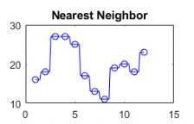
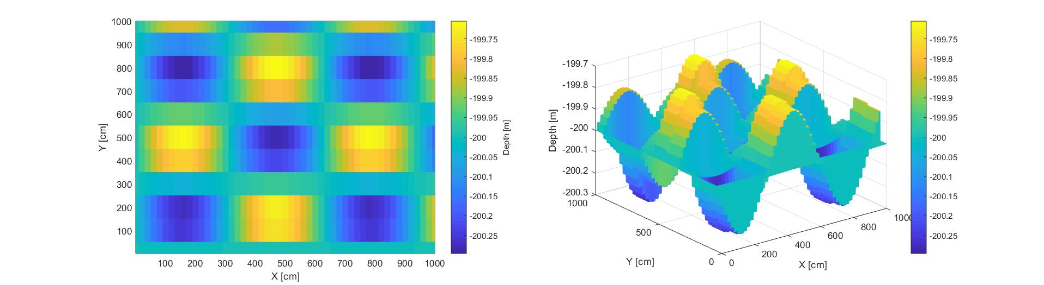
Nearest Neighbour Interpolation
This method sets the value of an interpolated point to the value of the nearest data point. Therefore, this method does not generate any new data points.
Error: 0.0019

Slide 7
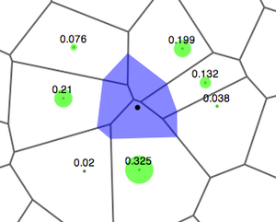

Natural Neighbour Interpolation
Technique for reconstructing a surface from irregularly distributed sample points.
This method is an efficient tradeoff between linear and cubic interpolation.
Error: 1.8280 e-04

Slide 8
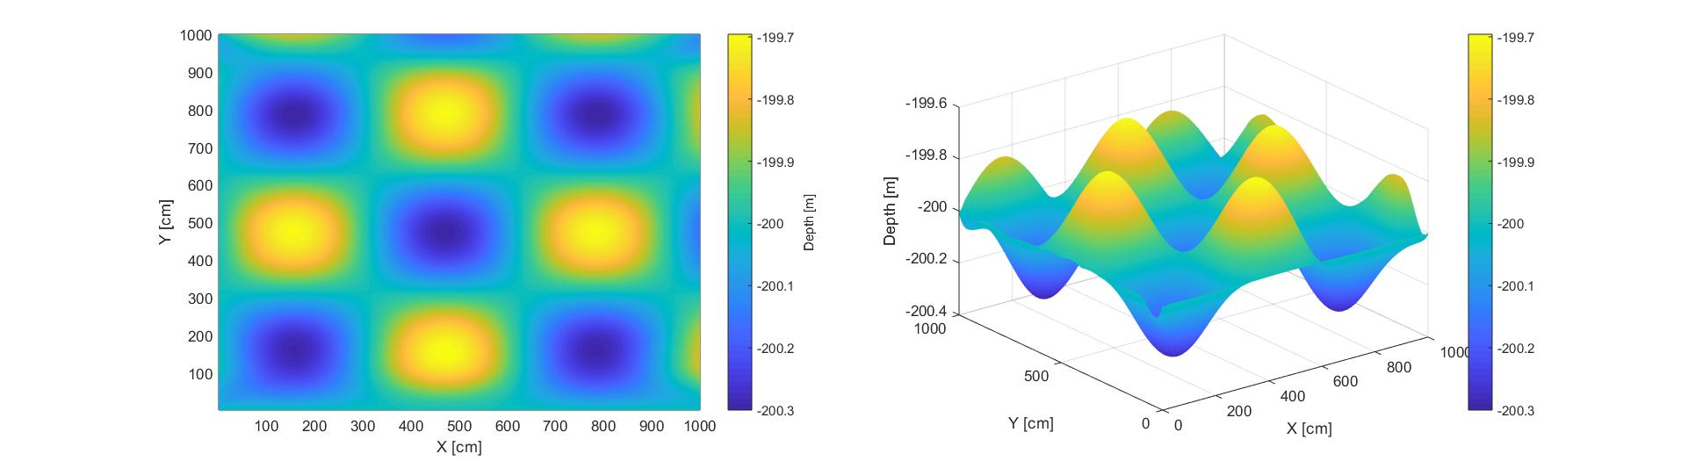
Biharmonic spline interpolation
Linear combination of biharmonic radial basis functions.
Unlike the other methods, this interpolation is not based on a triangulation.
Error: 1.0247 e-04

Slide 9
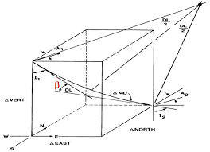

Minimum Curvature
Fitting of traditional interpolation two-dimensional splines to the observed data. The surface must pass exactly through the data points and must have minimum curvature.
Error: 1.2566 e-05

Slide 10
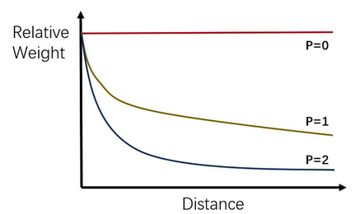

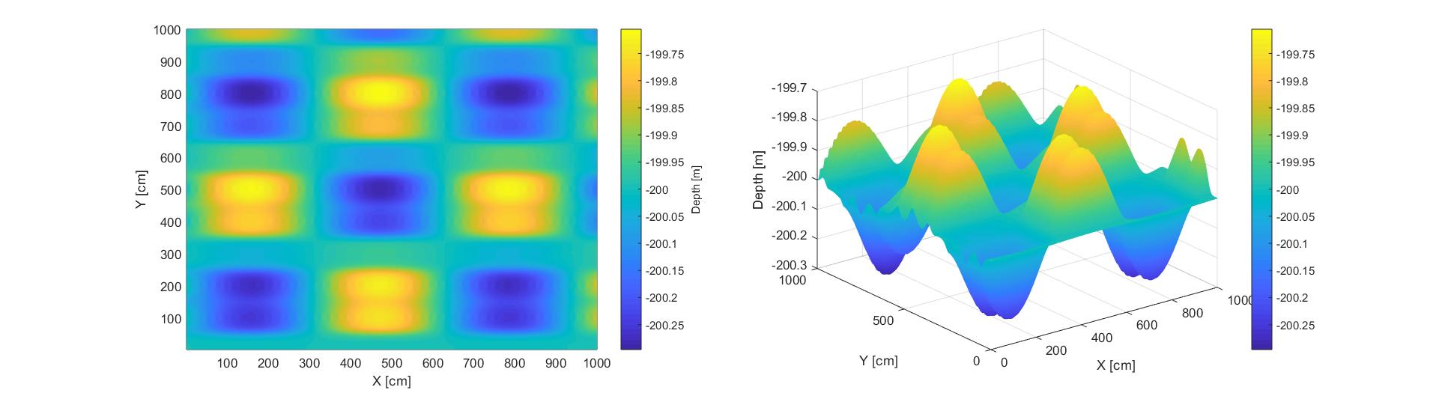
Shepard Interpolation
The assigned values to unknown points are calculated with a weighted average of the values available at the known points. The weights are computed as follows:
Where p is a real positive number called the power parameter.
Error: 8.7874 e-04 with p=4

Slide 11
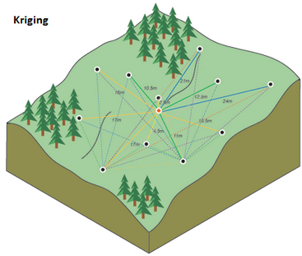
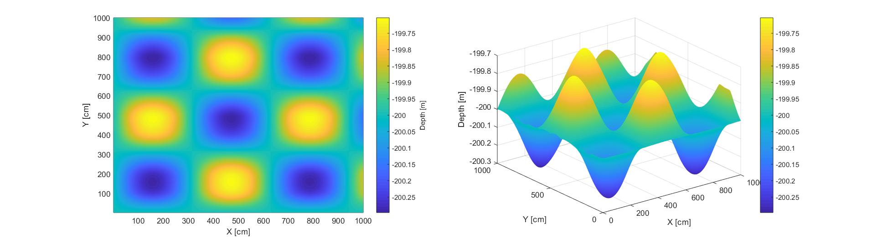
Kriging Interpolation
Method of interpolation for which the interpolated values are modeled by a Gaussian process governed by prior covariances.
Error: 3.3846 e-05

Slide 13

Work in Progress

